Slide 1



DYNAMIC EMERGENCY CORRIDOR – SMART AMBULANCE TRAFFIC CLEARANCE SYSTEM

Slide 2
THE PROBLEM AND WHO IS AFFECTED
AMBULANCES CAN LOSE VALUABLE TIME IN HIGHWAY TRAFFIC BECAUSE NEARBY DRIVERS AND TRAFFIC AUTHORITIES MAY NOT KNOW THAT AN AMBULANCE IS APPROACHING UNTIL IT IS VERY CLOSE.
  🚑 AMBULANCE & PATIENT – DELAYS CAN INCREASE THE TIME NEEDED TO REACH THE HOSPITAL.
  👨‍⚕️ EMERGENCY MEDICAL TEAMS – THEY MAY STRUGGLE TO REACH THE DESTINATION QUICKLY.
  🚗 OTHER VEHICLE DRIVERS – THEY MAY NOT KNOW WHERE OR WHEN TO CREATE A PATH.
  👮 TRAFFIC POLICE – THEY MAY RECEIVE INFORMATION TOO LATE TO MANAGE TRAFFIC EFFECTIVELY.
  🏥 HOSPITALS – DELAYED AMBULANCE ARRIVAL CAN AFFECT EMERGENCY TREATMENT.
Current World Situation
  Ambulances often get stuck in traffic.
  Drivers may not know an ambulance is approaching.
  Sirens give warning only when the ambulance is nearby.
  Traffic police may not get advance information.
  This can cause delays in emergency treatment.

Slide 3
PROPOSED SOLIUTION
We propose a **Dynamic Emergency Corridor System**.
When an ambulance begins an emergency trip, the ambulance application sends its real-time location to the backend.
The backend:
1. Identifies the ambulance's location.
2. Determines its direction of travel.
3. Determines its speed.
4. Identifies the highway segment ahead.
5. Creates an emergency corridor.
6. Identifies relevant vehicles inside the corridor.
7. Sends alerts to those vehicles.
8. Notifies traffic police.
9. Continuously updates the corridor as the ambulance moves.
10. Removes the emergency corridor after the ambulance passes.
The initial prototype uses a **500-metre alert corridor**.
Menu

Slide 4
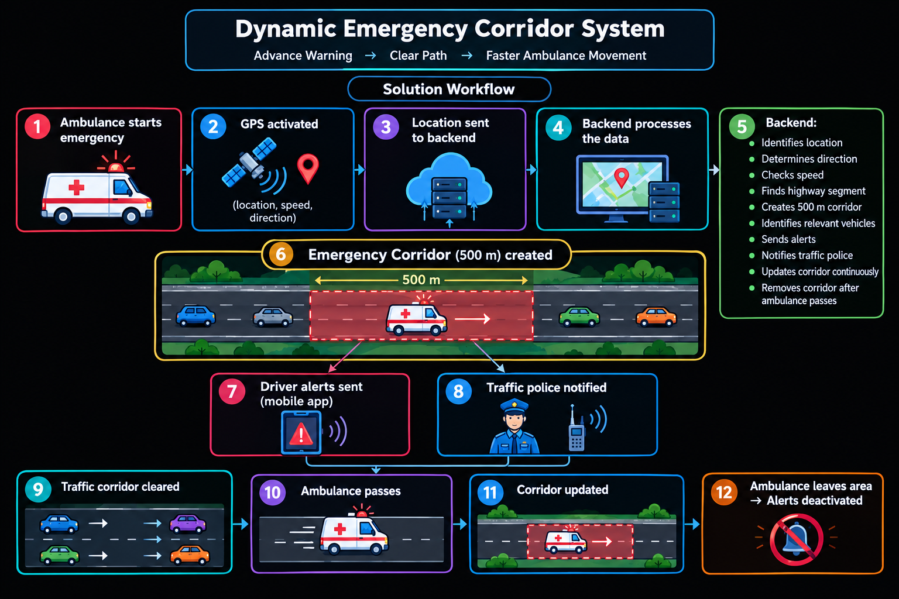

The complete workflow is:
```text
Ambulance Starts Emergency
↓
GPS Activated
↓
Location Sent to Backend
↓
Ambulance Direction Identified
↓
Emergency Corridor Created
↓
Vehicles in Corridor Identified
↓
Driver Alerts Sent
↓
Traffic Police Notified
↓
Traffic Corridor Cleared
↓
Ambulance Passes
↓
Emergency Corridor Updated
↓
Ambulance Leaves Area
↓
Alerts Deactivated
```

Slide 5
✅ Advantages
  Faster ambulance movement – Helps reduce delays in traffic.
  Advance warning – Drivers get alerts before the ambulance arrives.
  Automatic corridor creation – Creates a temporary emergency zone around the ambulance.
  Real-time tracking – GPS continuously tracks ambulance location and direction.
  Traffic police support – Police receive alerts to manage traffic.
Menu
Innovative AI Presentation

Slide 6
. FEASIBILITY
Technical Feasibility
  GPS can track the ambulance location, speed, and direction.
  ESP32 can be used for the prototype traffic signal.
  Firebase can handle real-time location and alert data.
  Mobile notifications can warn nearby drivers.
  Google Maps API can help identify the road and route
ECONOMIC FEASIBILITY
  ESP32, GPS MODULE, LEDS, AND SENSORS ARE LOW-COST.
  FIREBASE HAS A FREE/LOW-COST OPTION FOR PROTOTYPE DEVELOPMENT.
  EXISTING SMARTPHONES CAN BE USED FOR TESTING.
  THEREFORE, THE PROTOTYPE CAN BE DEVELOPED AT LOW COST.
OPERATIONAL FEASBILITY
  AMBULANCE STAFF CAN ACTIVATE AN EMERGENCY MODE THROUGH THE APP.
  DRIVERS RECEIVE A SIMPLE WARNING SUCH AS “EMERGENCY VEHICLE AHEAD – CLEAR PATH.”
  TRAFFIC POLICE CAN RECEIVE THE SAME EMERGENCY INFORMATION THROUGH A DASHBOARD.
Menu
Intelligent Systems

Slide 7
CONCLUSION
The **Dynamic Emergency Corridor** is a proposed smart traffic management system designed to help ambulances move more efficiently through highway traffic.
By combining GPS tracking, real-time communication, vehicle alerts, traffic-density information, ETA calculation, and traffic-police coordination, the system creates a temporary emergency corridor ahead of an ambulance.
The initial prototype focuses on a 500-metre alert zone, while future versions can dynamically adjust the corridor based on speed, traffic density, and estimated arrival time.
The most important principle of the project is:
> **Do not wait for the ambulance to reach the traffic. Warn the traffic before the ambulance arrives.**
The proposed system can serve as a foundation for future integration with connected vehicles, highway infrastructure, traffic signals, navigation platforms, and intelligent transportation systems.

Slide 8
Gravity Tech
Home
About Us
Menu
THANK YOU
SEE YOU NEXT TIME
2027
www.reallygreatsite.com
Innovative AI Presentation

